Slide 1
Grouping and Predicting House Prices

Slide 2
Exploratory Data Analysis
Get initial idea for data shape, feature data types, data distribution, and missing values
Evaluated numerical and categorical data separately for missing values and correlation
Numerical data
Correlation between all numerical features
Decided to drop ‘Unnamed: 0’, 100% correlation with ‘Id’
Correlation between all numerical features and target feature (‘SalePrice’)
‘OverallQual’, ‘GrLivArea’ ‘GarageCars’, ‘GarageArea’, ‘TotalBsmtSF’ > 60% correlation
Examined missing data and determined how to handle it
3 features were to be imputed with their median
Categorical data
Examined number of missing observations per feature
Determined to drop 4 features
‘Alley’, ‘PoolQC’, ‘Fence’, ‘MiscFeature’
Remaining missing values were chosen to be imputed
Notes:
Simrun

Slide 3
Train and Test Data Processing
all train and test data processing completed in test_data_prediction with helper functions
drop features missing over 80% of observations
imputation: imputes missing numerical values with the median and categorical values with the mode
numerical_feature_standardize: standardizes train and test numerical features
cateogrical_feature_encoding: applies one hot encoding to nonbinary categorical features
feature_engineering: drops one feature if correlation to another feature is above 0.95; combines binary features using OR operator
pca: applies PCA to reduce dimensionality to 35
Notes:
Melissa
to explain the train and test data processing in our final model; primary difference between our alpha model and test data is reorganizing our code into the test_data_prediction function and several helper functions
for our workflow, the given train and test csv files are imported to the notebook as dataframes and are used as arguments for test_data_prediction to process both datasets simultaneously
we first identify features in the train data missing over 80% of observations and drop them from both the train and test data
wrote function called imputation to handle the remaining missing values
another function of ours called null_columns is called to make a dictionary with the keys as missing value features and the values as the percent of missing data
if the feature is numerical, the missing values are imputed with the median
if the feature is categorical and more than 40% of the data is missing, the missing values are imputed with a new category called “Missing_Data”
otherwise, the missing categorical values are imputed with the mode
we also wrote another function numerical_feature_standardize to standardize the numerical features for both the train and test data
we separate the numerical data from the train and test data
we store the ‘Id’ and ‘SalePrice’ columns in variables and drop from datasets
then fit sklearn’s StandardScaler with train numerical data, standardize the train and test data, and then concatenate ID and SalePrice back to the dataframes
after standardization, we handle categorical features using one hot encoding in the function categorical_feature_encoding
for each categorical feature, we save all the other features in a variable
if the feature is already binary, we convert the two values to either 0 or 1 in the train and test data
otherwise, we use LabelEncoder and LabelBinarizer
both models are fit with the feature in the train data and then the fitted model is used to transform the train and test feature
at the end, we concatenate the encoded feature with the remaining data in their respective train and test data sets
we also wanted to perform feature engineering to combine features with high correlation
we first construct a correlation matrix
if the correlation coefficient of two features in the train data is equal to or greater than 0.95, one of the features is dropped
if two features are binary, which is likely from the encoded categorical features, and if they have a correlation coefficient equal to or above 0.6, we make a new feature combining the two using element-wise OR operation and we drop the original features
at this point, the number of features was around 250, with the increase attributed to the one hot encoding so we applied principal component analysis, or PCA, to reduce the dimensionality
the ‘Id’ and ‘SalePrice’ columns are stored in variables and dropped from both datasets
we fit sklearn’s PCA with the train data and apply the fitted model to transform the train and test datasets, reducing the number of features to 35
concatenate the respective ‘Id’ and ‘SalePrice’ columns were then concatenated to the train and test datasets

Slide 4
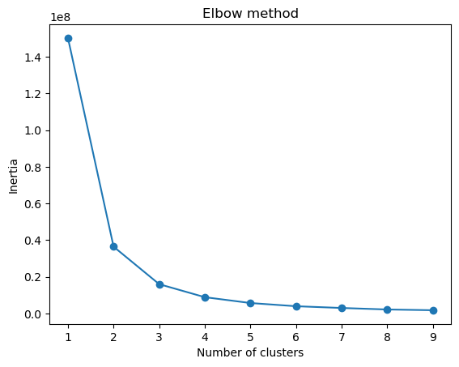
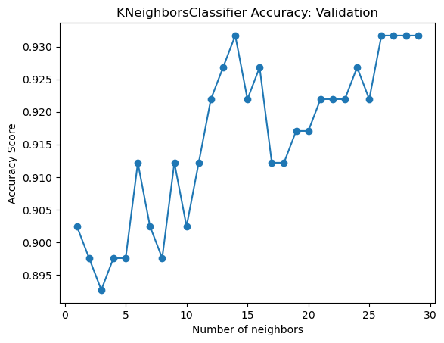
Data Subgrouping
split data into train (80%) and validation (20%)
plot_inertia: elbow method to find ideal k number of clusters
kmeans_clustering: cluster the train data with k=3 for the alpha model and k=4 for the final
KNN_classifer: applies KNN classifier with grid-search cv
n neighbors from 1 to 30
uniform vs. distance weighting
accuracy scores typically above 0.90; accuracy of validation clustering 0.93
Notes:
Melissa
at this stage, we split the train data into train and validation data, which is respectively 80% and 20% of the given data set.
we used the given class function plot_inertia to graph the error of k-means clustering vs. number of clusters in the range 1 to 10
using the elbow method, we initially selected k equals 3 for the number of clusters for our alpha model
for the final model, we observed a reduction in the overall MSE with k equals 4 so we chose four subgroups
in the function kmeans_clustering, we create a KMeans model fitted with the train features data and use the fitted model to predict the clusters for the train and validation data
after predicting the clusters for each datapoint, another function KNN_classifer builds a KNeighborsClassifier for the number of neighbors in the range 1 to 30
we fit the classifier with train data and the target clusters set with kmeans_clustering and predict the clusters of the validation data
the accuracy of the validation cluster predictions is plotted against the number of neighbors tested
we validate this model using grid-search cross-validation and we kept the same parameters used in the alpha model
we checked the number of neighbors in the range of 1 to 30 and ‘uniform’ or ‘distance’ weights, meaning equal weighting across all points in a cluster or weighting that awards greater influence to the closest neighbors
the mean accuracy scores were typically above 0.90, and the best accuracy score and parameters were printed
in this case, the best parameters were n neighbors equalling 29 and uniform weighting, with the accuracy of validation clustering being 0.93

Slide 5
Training: Prediction Model Training
2 Stages: Individual Model Training, Stacking Method Model Training
Individual Model Training
Algorithms:
Base Algorithms: Stochastic Gradient Descent, Decision Tree Regression, Support Vector Machine Regression, Neural Network Regression
Additional Algorithms: Linear Regression, Lasso Regularization, Ridge Regularization
k trained models per algorithm, k = number of groups made during data subgrouping
GridSearchCV used for fitting
Stacking Method Model Training
Stacking Method Models on Grouped Datasets
k trained models, used trained individual models as estimators and Random Forest Tree Regression as final estimator
Stacking Method Model on Entire Dataset
Singular model, results from stacking method on grouped dataset used as estimators and Random Forest Tree Regression as final estimator
Serves as secondary evaluation metric in Prediction Model Testing
Notes:
Simrun

Slide 6
Evaluation: Prediction Model Testing
Evaluated on 2 different versions of Test Dataset
Grouped: Test Data split into the k subgroups from the Data Subgrouping stage
Non-Grouped: Test Data before subgrouping
Evaluated using 3 methods
Individual Group MSE
Used models produced by Stacking Method on Grouped Datasets to predict Grouped Test Dataset
k MSEs reported, an MSE for each individual group’s stacking model
Non-grouped MSE
Used model produced by Stacking Method on Entire Dataset to predict Non-Grouped Test Dataset
1 MSE reported
Overall MSE of Grouped Dataset (final reported MSE)
Used models produced by Stacking Method on Grouped Datasets to predict Non-Grouped Test Dataset
Ran model_i on observations where k = i, for every i
1 MSE reported, the total loss based upon the Individual Group loss reported by Individual Group MSE
Notes:
Simrun

Slide 7
Conclusions
data processing: imputation, standardization, one hot encoding, feature selection and engineering, dimensionality reduction
subgrouping: k-means clustering, KNN, grid-search cross-validation
algorithmic training: SGD, decision trees, linear regression, lasso and ridge regularization, support vector machine, and neural networks
overall MSE: 707131939
future improvements: re-evaluate feature engineering, number of clusters and parameters for KNN classifier, and choice of algorithms and their parameters
Notes:
Melissa
To summarize the workflow implemented in test_data_prediction
the features with over 80% missing data are dropped
the missing values are imputed with the median for numerical data or the mode or “Missing_Data” for categorical data
numerical data is standardized and categorical data is converted to binary data through one hot encoding
feature engineering is performed to construct new features via element-wise operations of two correlated features, and PCA is applied for dimensionality reduction
After splitting the train data into train and validation sets, k-means clustering is used to divide the data into four subgroups, and a KNN classifier is built to predict the clusters for the test data
for our algorithms to predict the target ‘SalePrice’ for each subgroup, we used stochastic gradient descent, decision tree regressor, linear regression, lasso and ridge regularization, support vector machine, and neural networks
The overall MSE using the stacking regressor applied to the subgroups was 707 million
For further improvements, we can re-evaluate our feature engineering to create additional new feature vectors based on correlated features, the number of clusters and parameters for the KNN classifier to determine the optimal subgrouping, and optimizing both the choice of ML algorithms and parameters evaluated for each algorithm

Slide 8
References
How to perform one hot encoding on multiple categorical columns - Data Science Stack Exchange
Python: Finding Missing Values in a Pandas Data Frame | by Kallepalliravi | Analytics Vidhya | Medium
Python: Handling Missing Values in a Data Frame | by Kallepalliravi | Analytics Vidhya | Medium
k-Neighbors Classifier with GridSearchCV Basics | by Salem O. | Medium
How to use Data Scaling Improve Deep Learning Model Stability and Performance - MachineLearningMastery.com
List Highest Correlation Pairs from a Large Correlation Matrix in Pandas? - Stack Overflow
List of Features With Strongest Correlation
Convert pandas Series to DataFrame - Stack Overflow
Types of Machine Learning Algorithms You Should Know | by Jose Fumo | Towards Data Science
How to Choose the Right Machine Learning Algorithm: A Pragmatic Approach
1. Supervised learning — scikit-learn 1.3.2 documentation
sklearn.ensemble.StackingRegressor — scikit-learn 1.3.2 documentation
Pandas vs NumPy in Data Science: Top 15 Differences
sklearn.model_selection.GridSearchCV — scikit-learn 1.3.2 documentation
Stacking- Ensemble Learning Method | python scikit-learn Demo
sklearn.metrics.mean_squared_error — scikit-learn 1.3.2 documentation
Python Stacking Regressor Mastery: From Basics to Advanced Tips
Stacking Ensemble Machine Learning With Python - MachineLearningMastery.com
9. Model persistence — scikit-learn 1.3.2 documentation
StackingRegressor: a simple stacking implementation for regression - mlxtend
How to save a trained model by scikit-learn? - Stack Overflow
Sort Correlation Matrix in Python - GeeksforGeeks
How to build and fill pandas dataframe from for loop? - Stack Overflow

